Slide 1
Diffraction
P47 – Optics: Unit 7

Slide 2
Unit 7
Course Outline
Unit 1: Electromagnetic Waves
Unit 2: Interaction with Matter
Unit 3: Geometric Optics
Unit 4: Superposition of Waves
Unit 5: Polarization
Unit 6: Interference
Unit 7: Diffraction
Unit 8: Fourier Optics
Unit 9: Modern Optics

Slide 3
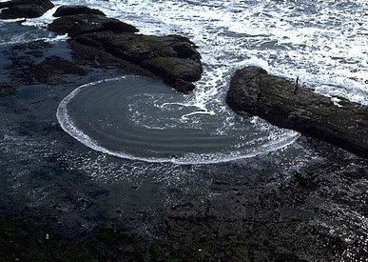
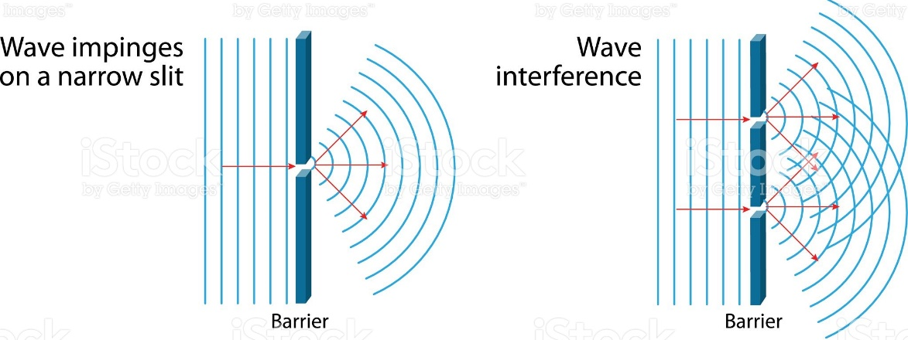
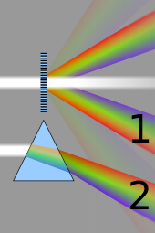
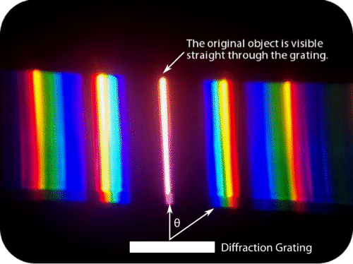
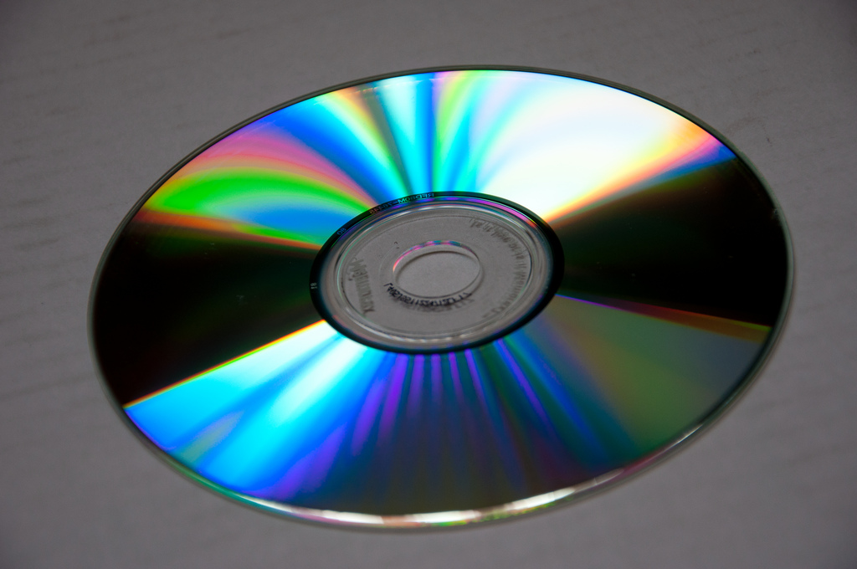
Unit 7
Diffraction

Slide 4
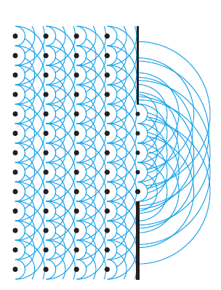
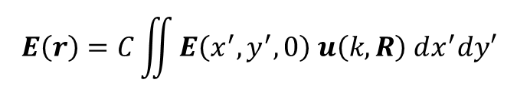
Unit 7
Single Slit Diffraction – The Huygens-Fresnel Principle
Light propagating through an aperture is a sum of “spherical wavelets”
$$E\left(r\right)=C\iint{E\left(x^{′},y^{′},0\right) u\left(k,R\right) dx^{′}dy′}$$
Incident light
(usually plane wave)
Diffracted “wavelet”
(downstream propagation)
This isn’t nearly as simple as it may seem.
Most of the challenge of diffraction theory involves doing this in a way you can actually solve!
Peatross & Ware

Slide 5
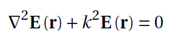
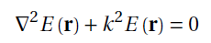
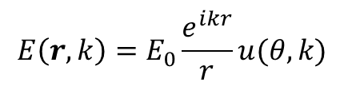
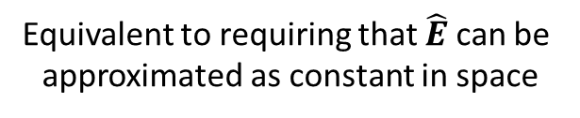
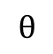
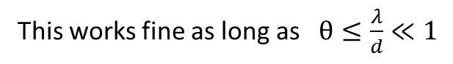
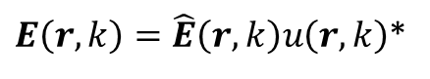
Unit 7
Scalar Diffraction Theory
We’ll treat the field as a scalar wave, ignoring polarization.
Vector Helmholtz Equation
Scalar Helmholtz Equation
$E\left(r,k\right)=\hat{E}\left(r,k\right)u\left(r,k\right)$*
$$E\left(r,k\right)=E_{0}\frac{e^{ikr}}{r}u(θ,k)$$
This works fine as long as $θ≤\frac{λ}{d}≪1$
$$θ$$
Equivalent to requiring that $\hat{E}$ can be
approximated as constant in space
*Vector diffraction theory is graduate-level electrodynamics, and well beyond the scope of this course. See Jackson Electrodynamics Ch. 10.

Slide 6
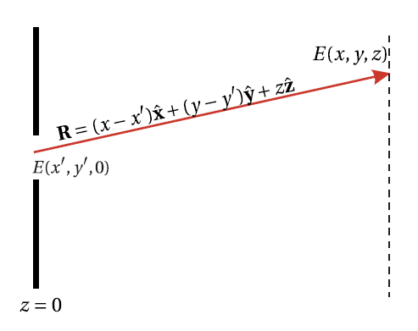
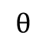
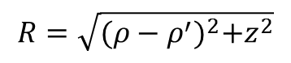
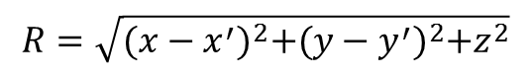
Unit 7
Coordinates in Diffraction Problems
The wavelet function $u\left(k,R\right)$depends on position in a non-trivial way:
$$R=\sqrt{{(x−x^{′})}^{2}+{(y−y^{′})}^{2}+z^{2}}$$
$$θ$$
$$R=\sqrt{{(ρ−ρ^{′})}^{2}+z^{2}}$$
Choose Cartesian or cylindrical coordinates depending on the symmetry of the aperture (if any)
Peatross & Ware

Slide 7
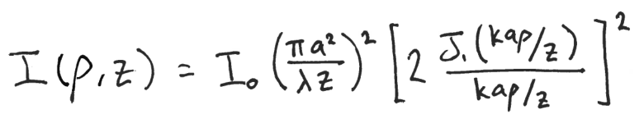
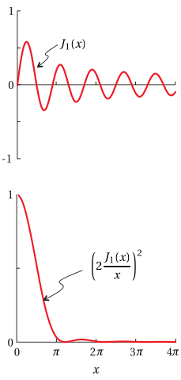
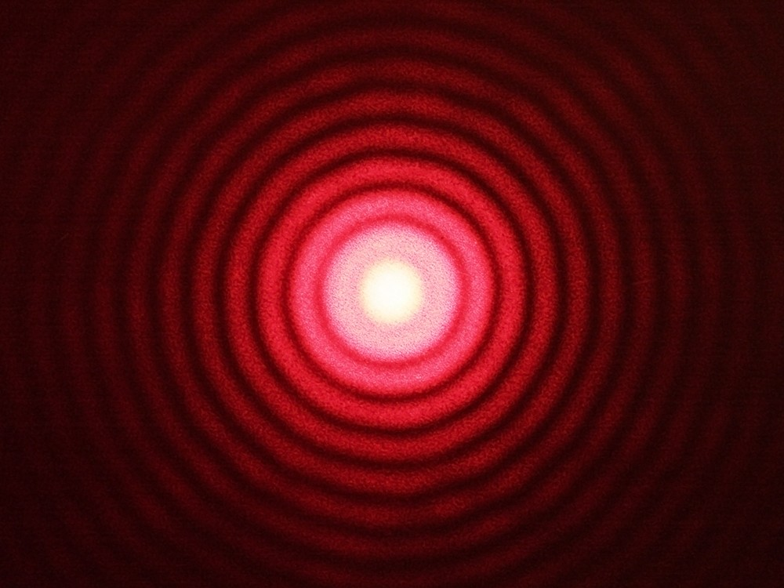
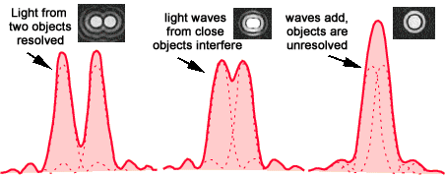
Unit 7
Airy Disk and Resolution Limit
Irradiance from circular aperture:
First-order Bessel function:

Slide 8
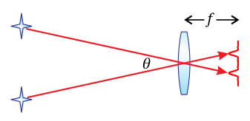
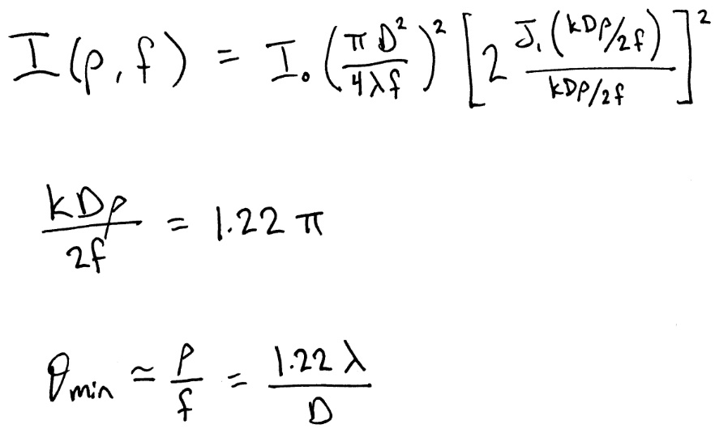
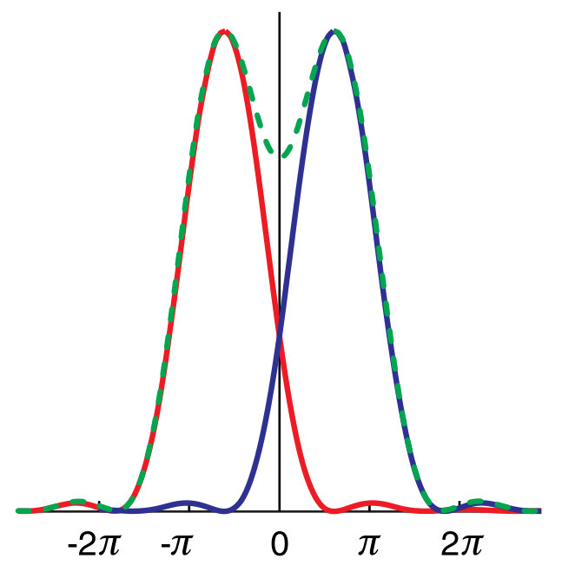


Unit 7
Airy Disk and Resolution Limit
Irradiance from lens aperture, diameter, D:
Resolution Limit:
When the first zero of one peak is at the same position as the second primary peak
Meet this condition when:
Have minimum resolvable angle
between two objects as:
The Diffraction Limit!

Slide 9
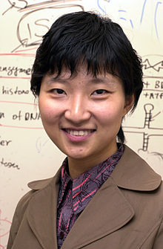
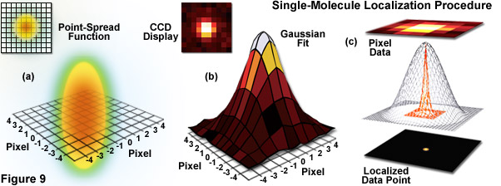
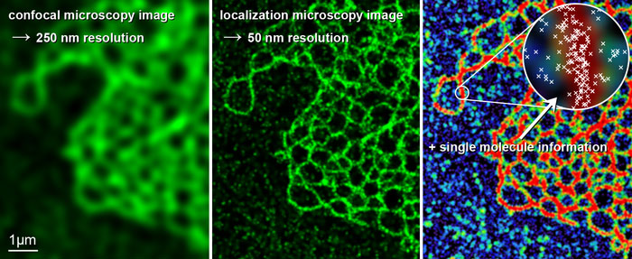
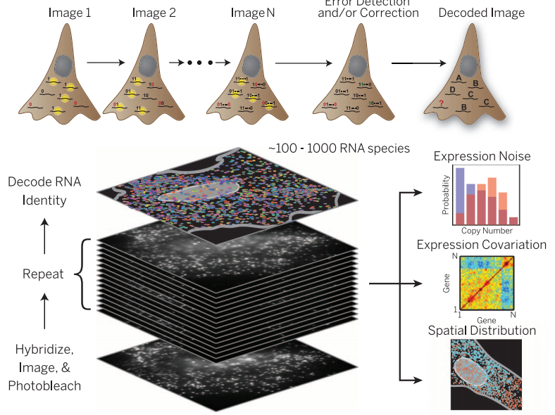
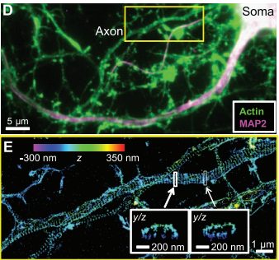
Xiaowei Zhuang - Harvard
Illuminating biology at the nanoscale with single-molecule
and super-resolution fluorescence microscopy

Slide 10
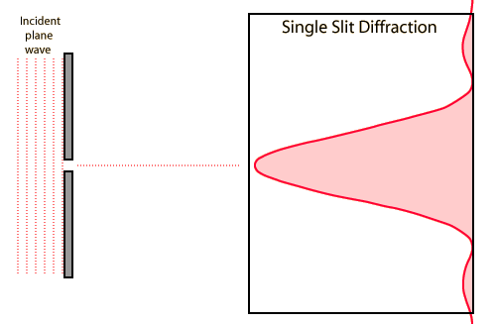
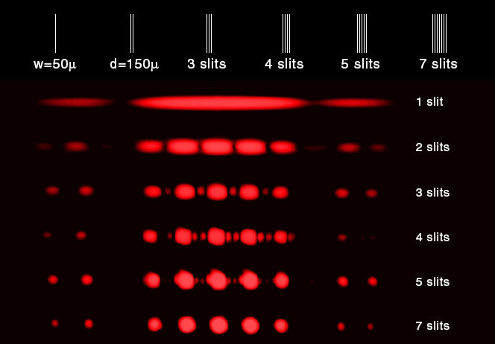
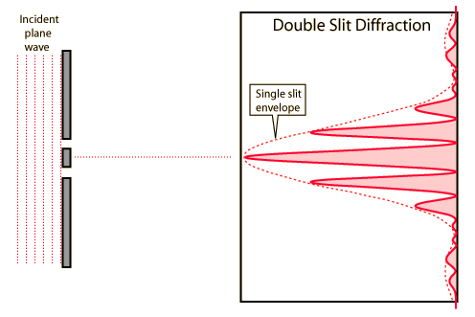
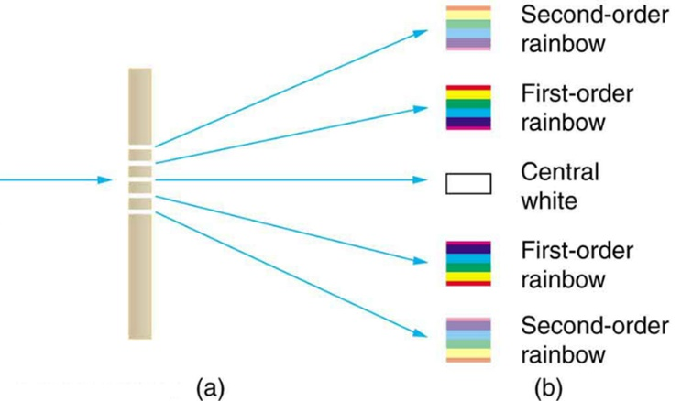
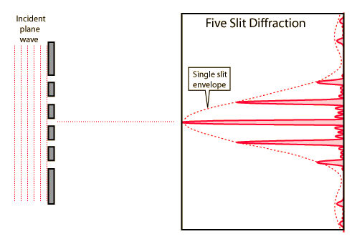
Unit 7
Multiple Slit Diffraction

Slide 11
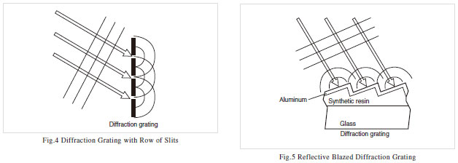
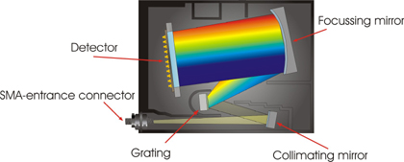
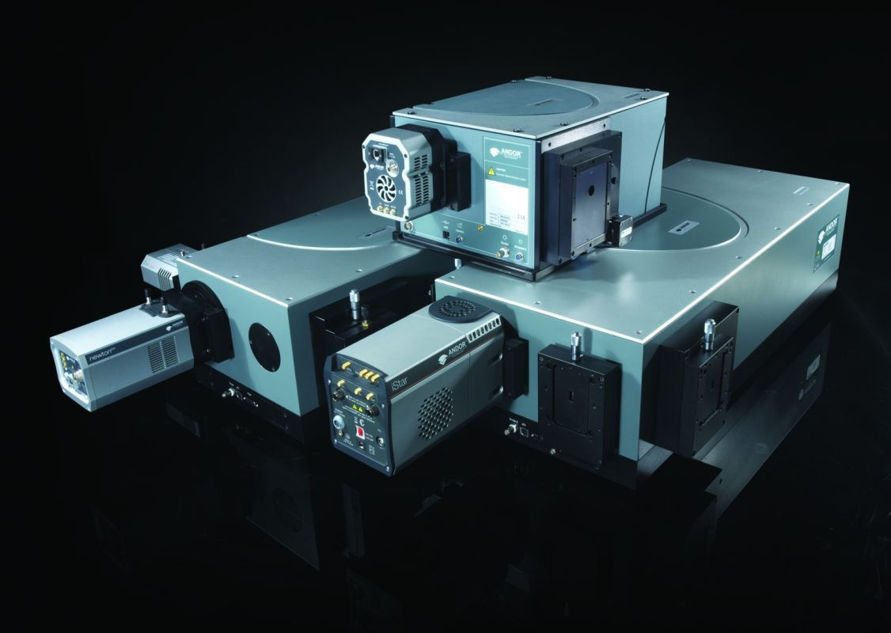
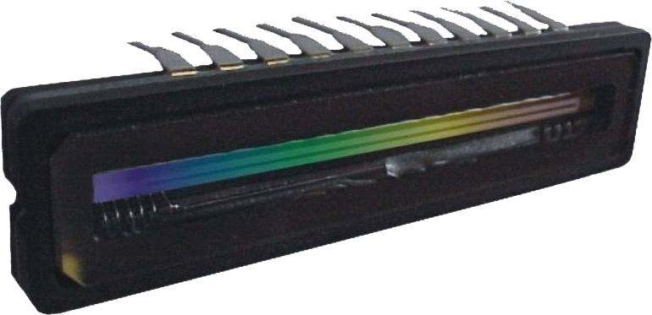
Unit 7
Equivalent Diffraction
Gratings and
Spectrometers

Slide 12
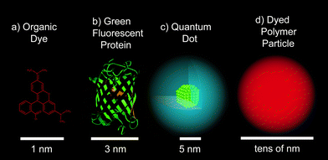
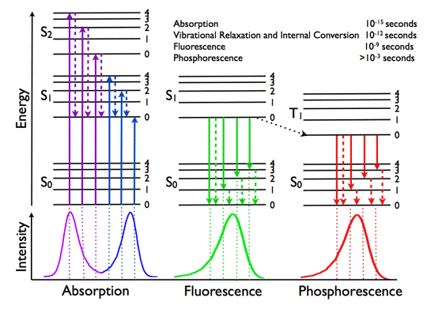
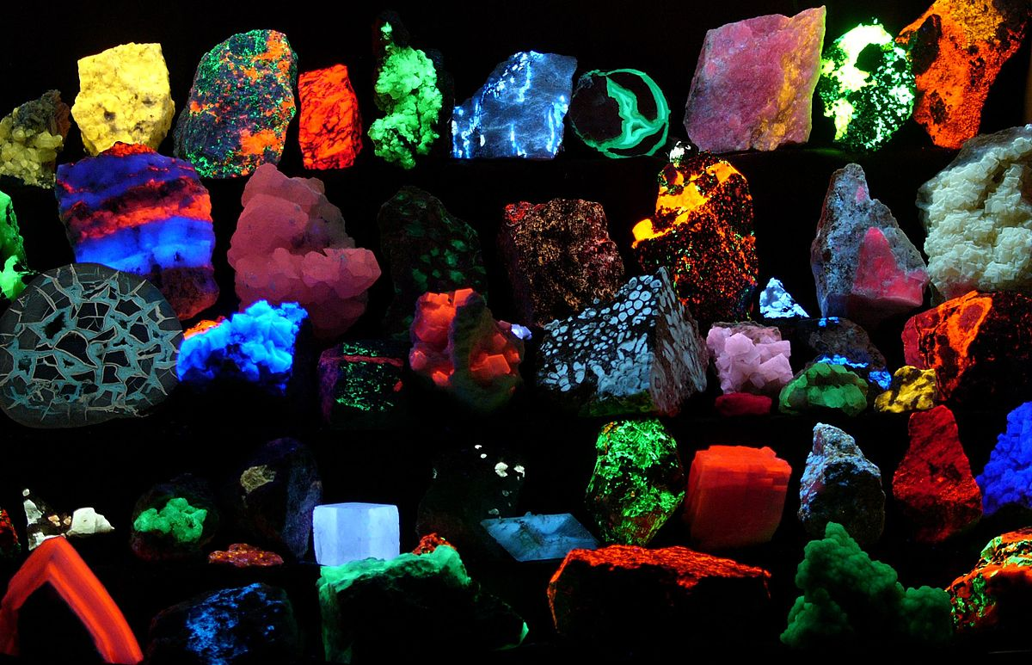
Unit 7
Luminescence Spectroscopy

Slide 13
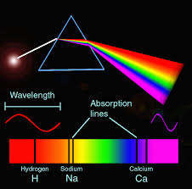
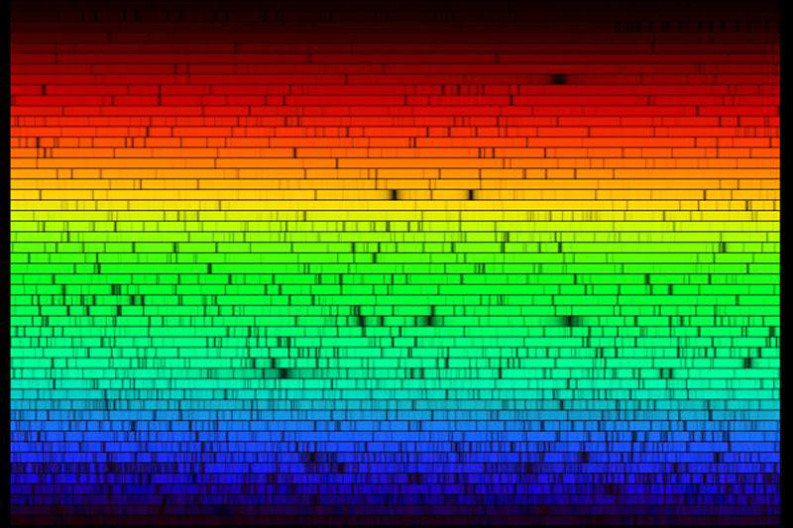
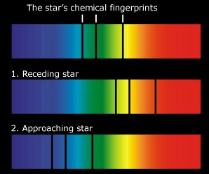
Unit 7
Stellar Spectroscopy
our sun

Slide 14
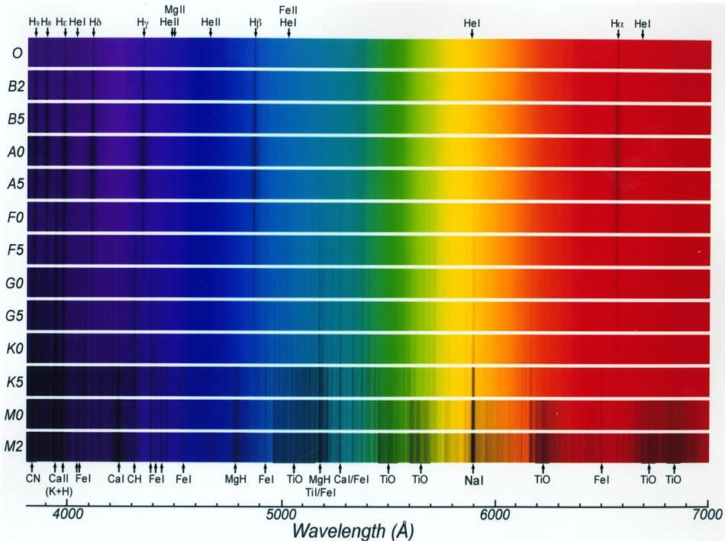
Unit 7
Stellar Spectroscopy
other suns

Slide 15
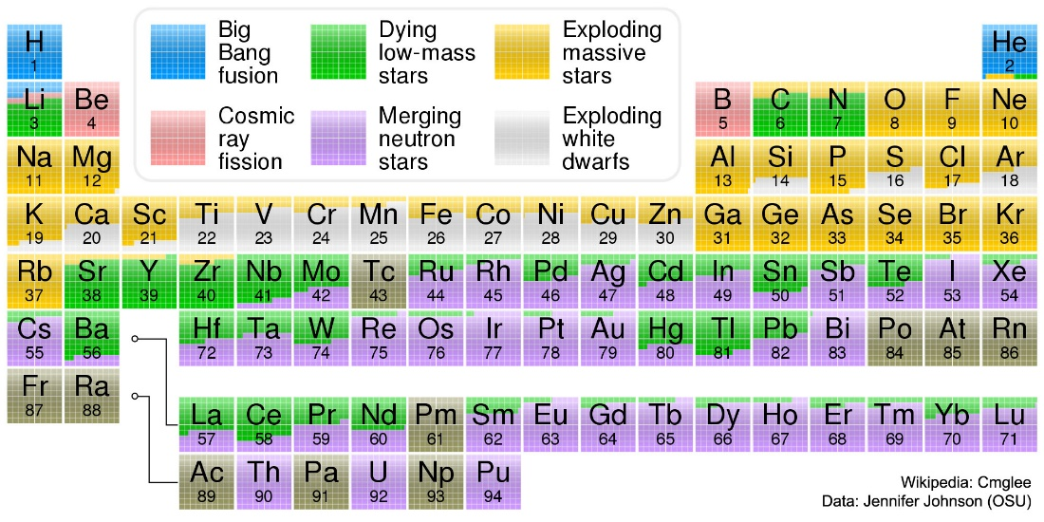
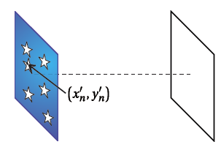
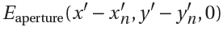
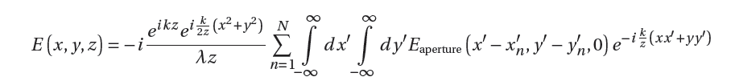





Unit 7
Array Theorem
Calculate the diffraction pattern caused by N identical apertures with
Each aperture has a location $\left(x_{n}^{′}, { y}_{n}^{′}\right)$, so that we use
Change of variables:

Slide 16



Unit 7
Array Theorem in the Real World:
Discrete Fourier Transform of 2D Images
For a list of N sample data points (1D)
$$F(u)=\frac{1}{N}\sum_{n=0}^{N−1}{f(n) e^{−i(2πnu)/N}}$$
For an MxN array of sample data points (2D)
$$F(u,v)=\frac{1}{NM}\sum_{n=0}^{N−1}{\sum_{m=0}^{M−1}{f(n,m) e^{−2πi(\frac{nu}{N}+\frac{mv}{M})}}}$$
A lot of work has been put into algorithms to
calculate this as efficiently as possible. (FFTW)
www.originlab.com

Slide 17



Unit 7
Fourier Optics: The Basic Idea
The intensity distribution in the far-field (Fraunhofer limit) is the 2D Fourier transform of the intensity distribution at the source.
A (perfect) lens causes the image at z=$∞$ to form at its focal distance.
Peatross & Ware

Slide 18

Unit 7
Babinet’s Principle
Array Theorem
Diffraction from a complicated aperture is just
the coherent sum of diffraction by its component parts
Reminder: add the electric field amplitudes, not the intensities!

Slide 19



Unit 7
Diffraction

Slide 20



Unit 7
The Arago Spot
What is the “correct” nature of light?
Corpuscular Theory of Light
Wave Theory of Light

Slide 21





Unit 7
Fresnel-Kirchoff – Circular Aperture
Example: What is the on-axis electric field due of a plane wave diffracting through a circular aperture?
$$ℓ$$
Change to cylindrical coordinates!
Peatross & Ware
Integration over $φ$ is trivial, integral over $ρ$ isn’t too bad…

Slide 22




Unit 7
On-Axis Intensity Behind Circular Aperture
a=10 microns
Lambda = 500 nm
Peatross & Ware

Slide 23


Unit 7
Fresnel Diffraction – Single Slit

Slide 24



Unit 7
Fresnel Diffraction – Circular Aperture
Intensity pattern at varying distances behind a circular aperture:
Has to be computed numerically
Bessel Function
Credit: MuthuKutty at en.wikipedia

Slide 25









Unit 7
Limits of Diffraction
Fraunhofer:
$$λ>\frac{d^{2}}{z}$$
Fresnel:
$$λ≅\frac{d^{2}}{z}$$
Geometric optics:
$$λ≪d, z$$
$$(λ→0)$$
Imagine illuminating the same slit with different wavelengths
Keeping everything else the same:
$←$Microwave
X-ray $→$

Slide 26
Unit 7
Diffraction

